Slide 1
Python I
Digital Literary Studies

Slide 2
Command Line
How do you know where you are?
How do you make a new folder?
How do you move in to a directory?
How do you see all the files in a directory?
How do you look up what a command does?

Slide 3
Python
What are some data types?
What is a variable?
How do you print something?

Slide 4
Python
What is an operator?
What is the Python interpreter?
How do you assign a variable?
How do you run a Python file?

Slide 5

Why Program?
Applications come from the needs of the present: your needs
﻿Effectively articulating needs is the first step
Express complex logic and perform computation
Do things that would take a human a long time to do
counting
comparing
repeating

Slide 6
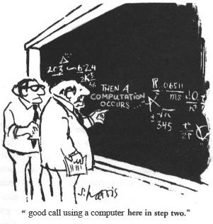
What is a programming language?
An artificial language with a limited purpose
A means of expressing computations (math) and algorithms (logic)

Slide 7
What is a programming language?
An artificial language with a limited purpose
A means of expressing computations (math) and algorithms (logic)

Slide 8
What is a programming language?
...like human languages in some ways!

Slide 9
Python
Python is a language
Libraries are called packages
Name is not a snake – it’s a Monty Python reference.
Notes:
Other things to add about it –
Syntax enforces good practices
Syntax matters
Good for doing things yourself
Flexible
legible
Difficult to manage installations sometimes

Slide 10
Python Philosophy:
Loaded into every Python installation as an easter egg:
>>> import this

Slide 11
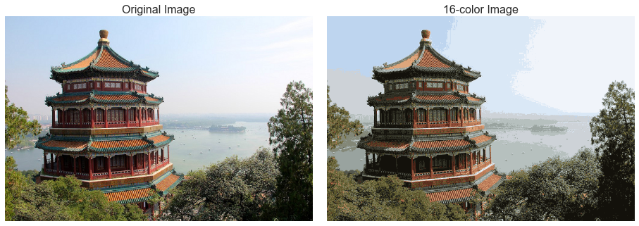
https://jakevdp.github.io/PythonDataScienceHandbook/05.11-k-means.html
Notes:
What kind of data is this -
Find an image –
get them to ideas about what kind of data the computer can extract
Second image to help – find a pixelated peg version that shows artifacts
Basically, a computer can only show color
So the problem in converting pixels to text – lots of overlap

Slide 12
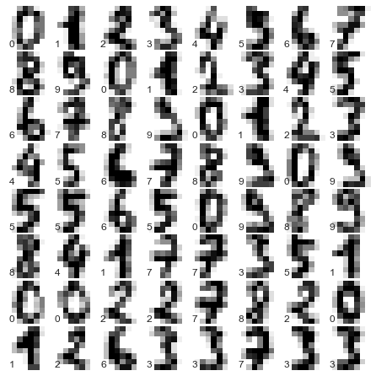
https://jakevdp.github.io/PythonDataScienceHandbook/05.08-random-forests.html
Notes:
What is this? What text looks like up close? What are some things we notice right away?

Slide 13
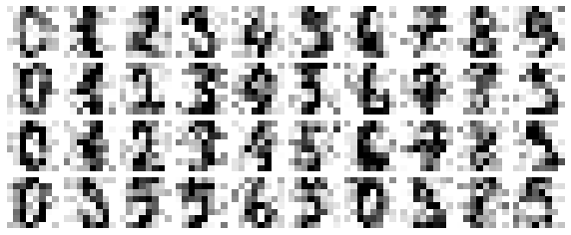
https://jakevdp.github.io/PythonDataScienceHandbook/05.09-principal-component-analysis.html
Notes:
Noisy Data – what do we think the pixels on the sides are? Is this more difficult to read or easier?

Slide 14
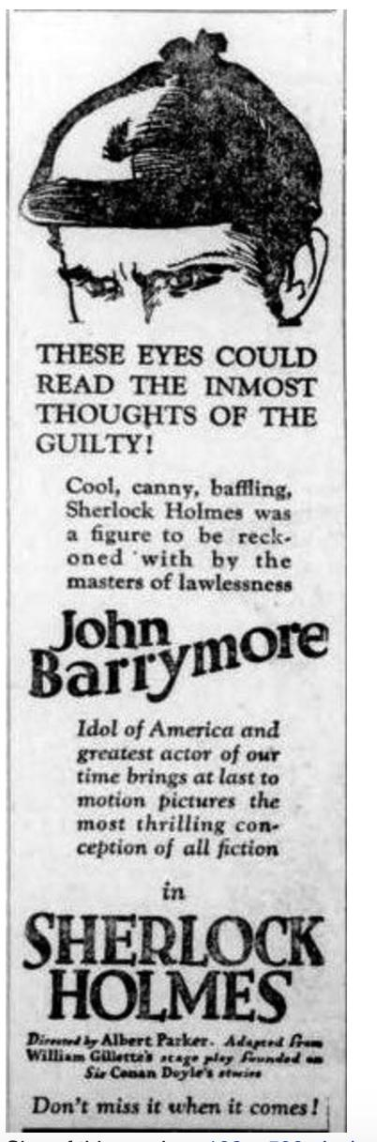
Notes:
Given what you saw in the reading – what are places where you could expect the computer to have difficulty? What would you be hoping to get out of it? How would a computer think about this? What would it expect to find?

Slide 15
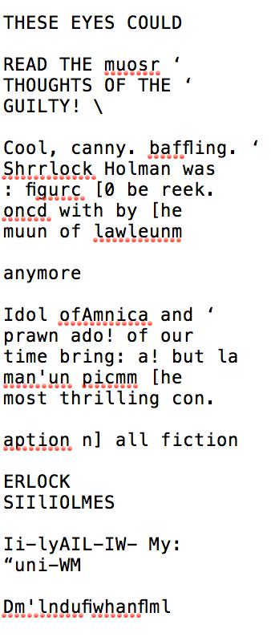
Notes:
What can we do with this? What are some things you know already that you can imagine using Python for this? How would you approach this problem?

Slide 16
Problems with data
Doyle Arthur Doyle
A.C. Doyle
Doyle, A.C.
Doyle, Sir Arthur
Doyle, Sir Arthur Conan
Sir Arthur Conan Doyle
Notes:
Probably Save this for data cleaning
What would you do to fix this? Why would you care?

Slide 17
Introductory Data Cleaning with Strings
$ cd projects
$ curl walshbr.com/materials/day2.txt > day2.txt
Copy the text from that document into your clipboard
$ python3

